Slide 1
Exploring Scrum Team Performance – Virtual Hand-out
Blake McMillan

Slide 2







Blake McMillan
Blake is a Principal Consultant at Improving with a focus on Agile/Scrum Coaching and Training; he is also a Professional Scrum Master III and Professional Scrum Product Owner II through Scrum.org working toward Professional Scrum Trainer.
He is the creator and blogger for SoulofScrum.com and is an experienced Facilitator and Public Speaker and is also a Board Member & Seminar Facilitator at CareerSolutions.
Connect with me
www.linkedin.com/in/blakemcmillan
Twitter: @soulofscrum
www.soulofscrum.com
Companies Supported

Slide 3
Goals for the Workshop
Exploring Scrum Team Performance
Review of metrics commonly used for Scrum teams
Discuss what makes metrics useful
Discover leading indicators for Scrum Team performance
Decide how to use this at work

Slide 4
Why use Scrum?
Exploring Scrum Team Performance
Work on the right thing…at the right time…all the time.
Incremental delivery of highest value to your customer.
Fast feedback from your customer.
Rapid Learning
Respond quickly to changes in business conditions

Slide 5
What is the primary measure of performance?
Exploring Scrum Team Performance
Delivering Value – Agile Principles 1, 3, & 7
Our highest priority is to satisfy the customer through early and continuous delivery of valuable software.
Deliver working software frequently, from a couple of weeks to a couple of months, with a preference to the shorter timescale.
Working software is the primary measure of progress

Slide 6

Leading vs Lagging Indicators
Exploring Scrum Team Performance

Slide 7
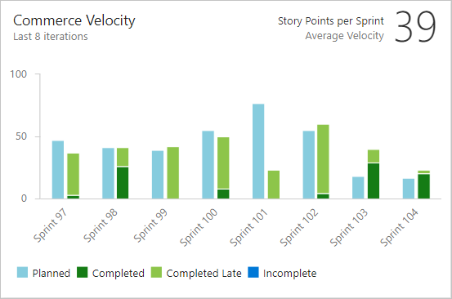
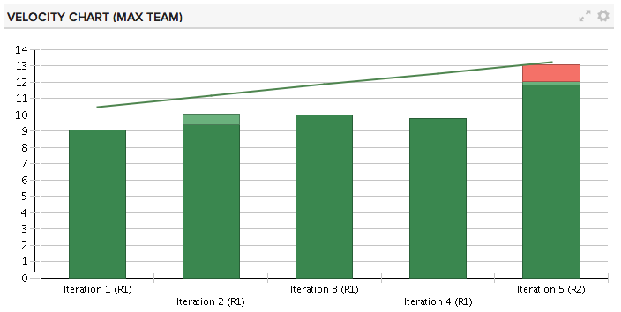
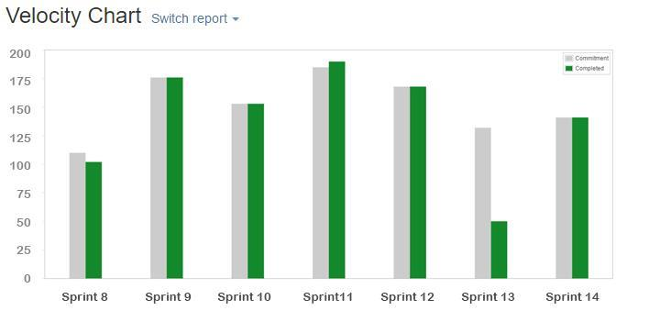
Scrum Team Metrics – Velocity Chart
Exploring Scrum Team Performance

Slide 8
Scrum Team Metrics – Velocity Chart
Exploring Scrum Team Performance
Leading or
Lagging?
How is it useful?
How is it not useful?

Slide 9
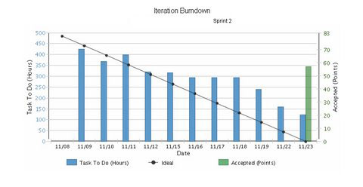
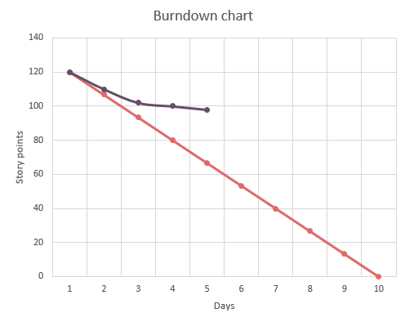
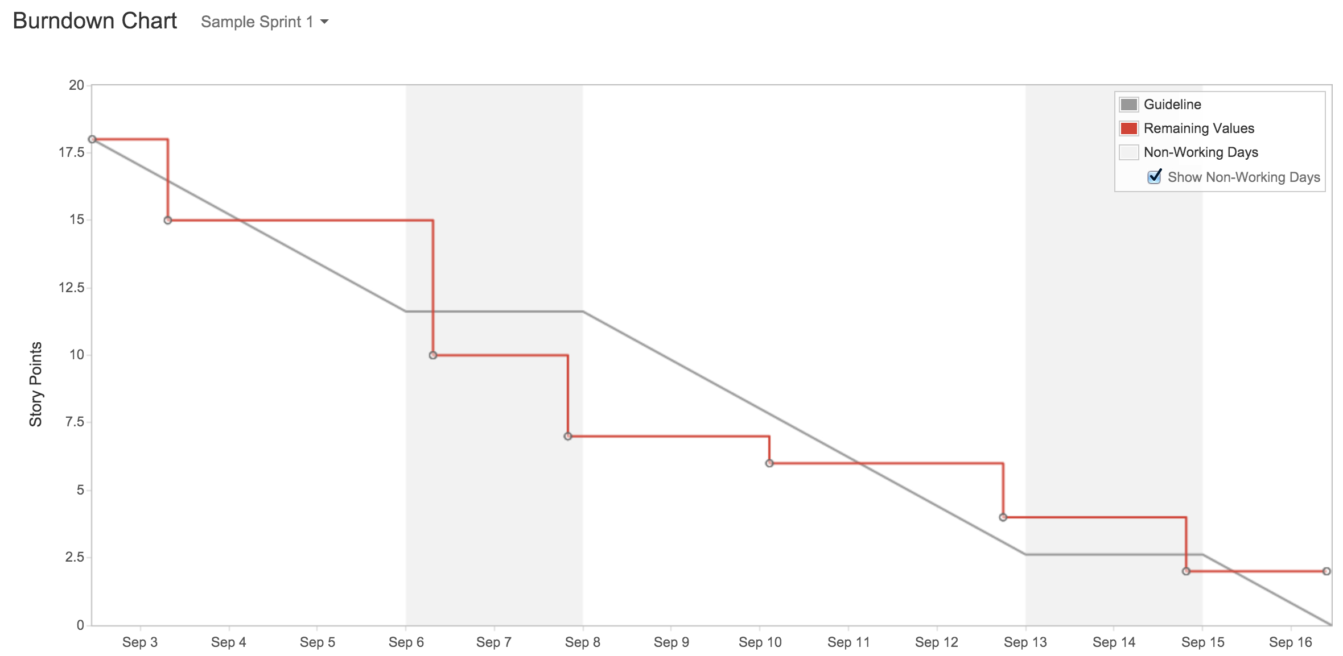
Scrum Team Metrics – Burndown Chart
Exploring Scrum Team Performance

Slide 10
Scrum Team Metrics – Burndown Chart
Exploring Scrum Team Performance
Leading or
Lagging?
How is it useful?
How is it not useful?

Slide 11
What are metrics good for in Scrum?
Empirical Process
Transparency
Inspection
Adaptation
Trust
Courage
Focus
Openness
Respect
Commitment
Black & white image ©arthursclipart.org
Notes:
Transparency
Significant aspects of the process must be visible to those responsible for the outcome. Transparency requires those aspects be defined by a common standard so observers share a common understanding of what is being seen.
Inspection
Scrum users must frequently inspect Scrum artifacts and progress toward a Sprint Goal to detect undesirable variances. Their inspection should not be so frequent that inspection gets in the way of the work. Inspections are most beneficial when diligently performed by skilled inspectors at the point of work.
Adaptation
If an inspector determines that one or more aspects of a process deviate outside acceptable limits, and that the resulting product will be unacceptable, the process or the material being processed must be adjusted. An adjustment must be made as soon as possible to minimize further deviation.

Slide 12
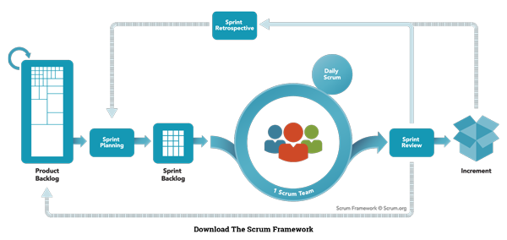
Can we use leading indicators for Scrum events?
https://www.scrum.org/resources/what-is-scrum

Slide 13



Before we continue…
…these should NEVER be used against the Scrum Team…but instead used by the Scrum Team for the Scrum Team’s Improvement.

Slide 14

An exercise in Self Organization
Notes:
Arrange yourselves into some discussion groups….no fewer than 3….no more than 9.
*Note: Should be at 15min mark for 1-hour workshop….if later…accelerate.

Slide 15
Sprint – Limit risk, get feedback, establish rhythm
Exploring Scrum Team Performance
Measure | Description
How was work today? ☺ or ☹ | Team Health…look for trends. Have conversations.
Cumulative OT for the Sprint | Sustainable pace?
Changes to Current Sprint | How many PBIs (not sub-tasks of stories) are added or removed after the Sprint has started?
Notes:
State Purpose, then give participants 30 seconds to ponder 2-3 min to discuss as a group. Before open room discussion.

Slide 16
Sprint Planning – Plan to deliver value during the Sprint
Exploring Scrum Team Performance
Measure | Description
# of No Shows | Scrum team members not showing up to Sprint Planning reduces planning effectiveness
Sprint Goal created? Y or N | Lack of Sprint Goal could indicate issues with PBI granularity or cohesiveness
Planning Diligence | # of tasks added after start of Sprint compared to percentage of time box used for Sprint Planning
Notes:
State Purpose, then give participants 30 seconds to ponder 2-3 min to discuss as a group. Before open room discussion.

Slide 17
Daily Scrum – Daily Plan to achieve the Sprint Goal
Exploring Scrum Team Performance
Measure | Description
# of No Shows | Dev team members not showing up to the Daily Scrum reduces planning effectiveness
# of Late Arrivals | A measure of focus and respect the team has for itself
# of Tasks that rollover | Focus, commitment, and collaboration…request for help before the Daily Scrum?
Notes:
State Purpose, then give participants 30 seconds to ponder 2-3 min to discuss as a group. Before open room discussion.

Slide 18
Sprint Review –Stakeholder and Scrum Team Collaboration
Exploring Scrum Team Performance
Measure | Description
# of Customers/ Stakeholders attended vs invited | Engagement measure by attendance of those outside the Scrum Team
# of changes to PB | How many new ideas came from the interactions in the Sprint Review?
# of PB prioritization changes | How did the interaction drive updates to PB prioritization?
Notes:
State Purpose, then give participants 30 seconds to ponder 2-3 min to discuss as a group. Before open room discussion.

Slide 19
Sprint Retrospective – Scrum Team Continuous Improvement
Exploring Scrum Team Performance
Measure | Description
# of No Shows | Scrum team members not showing up to Sprint Retrospective reduces effectiveness of continuous improvement idea generation and analysis
# of new improvements | How many improvements were added to the next Sprint Backlog? <1? Discuss.
% of completed improvements | How many improvements were completed in the current Sprint Backlog? If zero…why?
Notes:
State Purpose, then give participants 30 seconds to ponder 2-3 min to discuss as a group. Before open room discussion.

Slide 20


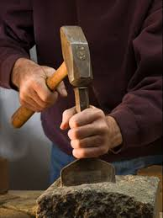
So what now?
Exploring Scrum Team Performance
Notes:
1, 2, 4, All

Slide 21
Is that all there is?
Exploring Scrum Team Performance
No…this material is presented as an interactive workshop that invites high levels of engagement and participation.
However I want to provide the metrics we discuss since I don’t print out hand-outs of the material.
If you would like me to facilitate this workshop for your organization reach out to me:
www.linkedin.com/in/blakemcmillan
Twitter: @soulofscrum
www.soulofscrum.com
Notes:
1, 2, 4, All

Slide 22
Goals for the Workshop
Exploring Scrum Team Performance
Review of metrics commonly used for Scrum teams
Discuss what makes metrics useful
Discover leading indicators for Scrum Team performance
Decide how to use this at work

Slide 23
Want to know more?
Exploring Agile and Scrum Alignment
www.agilemanifesto.org
www.scrum.org
www.improving.com
Connect with me
www.linkedin.com/in/blakemcmillan
Twitter: @soulofscrum
www.soulofscrum.com

Slide 24
Thank you!
Connect with me
www.linkedin.com/in/blakemcmillan
Twitter: @soulofscrum
www.soulofscrum.com
Improving
www.improving.com

